Slide 1
Project 2
Tanner Hall, Sean Horner, Kyle Pacheco

Slide 2
Project Goals and Responsibilities
Goals
Gather Twitter data via Twitter API
Create a Spark application that processes Twitter data
Approximate tweet count for the day, word count, most popular hashtags, retweet percentage, following character probability.
Create a Twitter bot that can take queries, call the Spark application, and reply
Responsibilities
Kyle wrote functions that can gather and parse data into Tweet and TwitterUser objects
Sean created the analysis engine that ran all analyses
Tanner put everything together and wrote the bot to take queries and post a response

Slide 3
Classes and the DAO

Slide 4
Necessary Objects
TwitterUser: |  | Tweet:
userId: Long | Unique ID given to user upon account creation | tweetId: Long | Unique ID given to each tweet upon posting
userName: String | Unique string chosen by user during account creation | authorId: Long | Unique ID of user who posted the tweet (same as userId field of TwitterUser object)
name: String | Name chosen by user
createDate: DateTime | Day and time user account was created | text: String | Text content of the tweet
description: String | Description set by user on profile
followers: Int | Number of followers for user
following: Int | Number of users following

Slide 5

Get User
Takes a unique ID or username
Sends GET request via Twitter V2 API
Parse JSON response into TwitterUser object

Slide 6
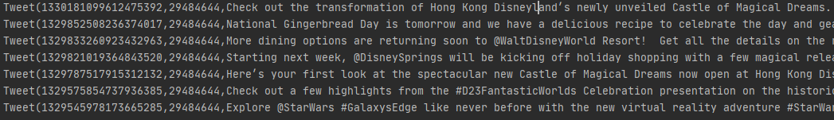
Get User Timeline
Takes a TwitterUser, a count for how many tweets you want returned, and optional boolean fields to exclude replies and retweets
Sends GET request via Twitter 1.1 API
Parse JSON response into a list of Tweet objects

Slide 7
Get Replies to Tweet (experimental)
Takes a TwitterUser and gets their timeline with getUserTimeline function
Does a recent search for all tweets that mention initial user and stores them into Tweet objects
Filters the response where the field “in_response_to_tweet_id” matches the tweet from the initial user’s timeline
Returns a list of Tweet objects which are replies to tweets on the initial user’s timeline

Slide 8
Analysis Engine

Slide 9
What is our Analysis Engine?
The Analysis Engine (AE) is the data processing mechanism used in the bot’s analyses.
After information is gathered and parsed through the DAO, the AE is instantiated and the user requested analysis is initiated on the gathered data.
There are seven methods and four sub-methods the AE uses to do its analyses.

Slide 10
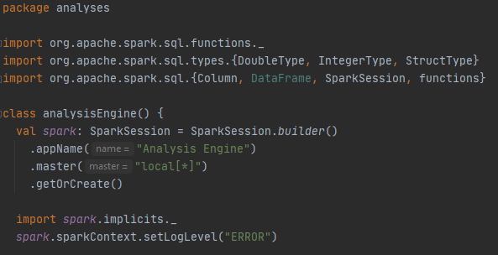
Analysis Engine Setup
Since the Analysis Engine is the only part of the code which uses Spark, it is responsible for creating its own SparkSession.

Slide 11
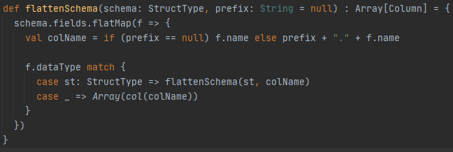
Sub-Method: flattenSchema
This method was pulled from a StackOverflow answer at: https://stackoverflow.com/questions/37471346/automatically-and-elegantly-flatten-dataframe-in-spark-sql/38460312
It takes any schema, rolls through it and if it discovers any nested columns it pulls them out ot the root level.

Slide 12
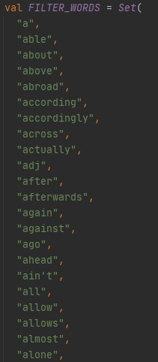
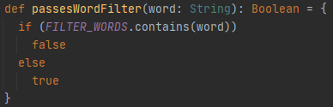
Sub-Method: passesWordFilter
The filter word list was modified from the one at:
https://www.link-assistant.com/seo-stop-words.html
This method takes checks if a given word is in the FILTER_WORDS set and if it is it returns a false value, otherwise it returns true.

Slide 13
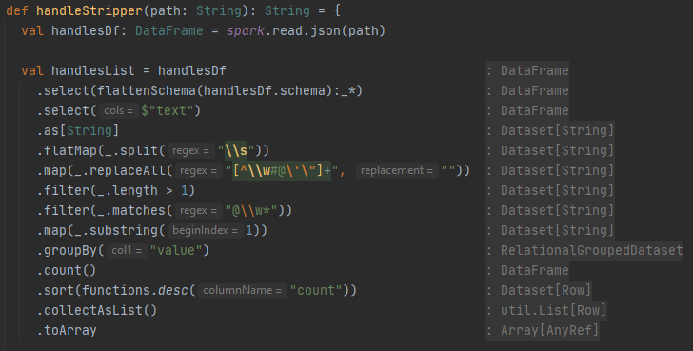
Method 1: handleStripper (Part 1)
Reads in the data
Splits the data into separate words
Removes all trivial characters
Filters for:
words longer than 1,
words starting with ‘@’
Slices off the ‘@’
Groups by word
Counts the groups
Sorts by count number
Collects the results and packages them into an Array

Slide 14
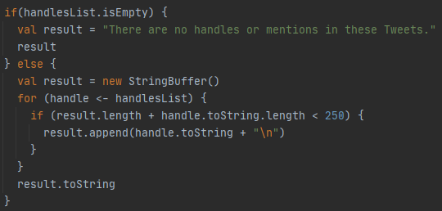
Sub-Method: StringBuilder
This sub-method appears at the end of:
handleStripper
hashtagStripper
wordCount
followingCharacter
It does the following:
Tests if the result Array is empty
Starts a foreach loop through each item in the list that:
Checks if the length of the current string plus the next item goes over the character limit
If not, it appends the item and moves on to the next
Stops when the limit is exceeded or the loop completes (i.e. list runs out of items)

Slide 15
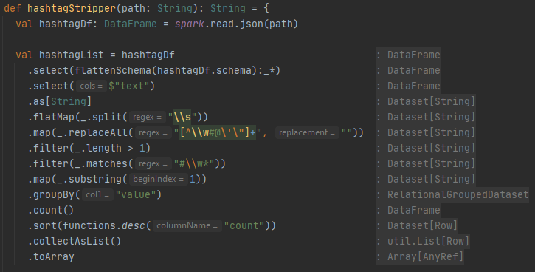
Method 2: hashtagStripper (excluding StringBuilder)
Reads in the data
Splits the data into separate words
Removes all trivial characters
Filters for:
words longer than 1,
words starting with ‘#’
Slices off the ‘#’
Groups by word
Counts the groups
Sorts by count number
Collects the results and packages them into an Array

Slide 16
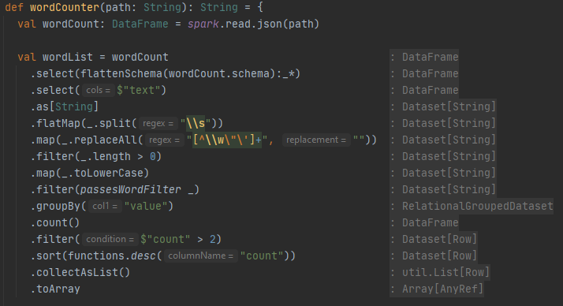
Method 3: wordCounter (excluding StringBuilder)
Reads in the data
Splits the data into separate words
Removes all trivial characters
Filters for Strings longer than 0
Makes all words lowercase
Filters for non-trivial words
Groups by word
Counts the groups
Filters for counts higher than 2
Sorts by count number
Collects the results and packages them into an Array

Slide 17
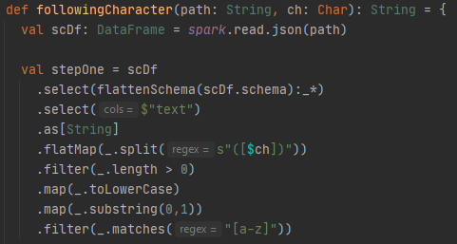
Method 4: followingCharacter (Step One)
In the first step, this method:
Reads in the data
Splits the data into separate words at the given character
Filters for Strings longer than 0
Makes all words lowercase
Chops off all but the first character
Filters for letters
Counts up the total number of instances that match the criteria, pre-combine and sort.

Slide 18
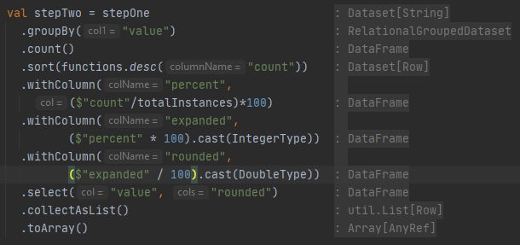
Method 4: followingCharacter (Step Two)
In the second step, the method:
Reads in the data from stepOne
Counts up the occurrence of each letter
Sorts the letters by count
Creates columns that:
Calculate the percentage as count / totalInstances * 100
Multiply the result by 100 and cast it to an Integer
Divides the result by 100 and cast it back to a Double
Collects the results and packages them into an Array

Slide 19
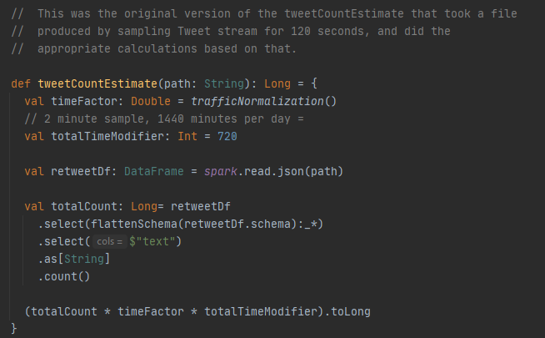
Method 5: tweetCountEstimate
Reads in the JSON
Counts up the total number of Tweets in the JSON
Gets the traffic normalization factor for the current time
Calculates the estimated number of daily tweets using the given formula.
trafficNormalization() is explained on the next slide.

Slide 20
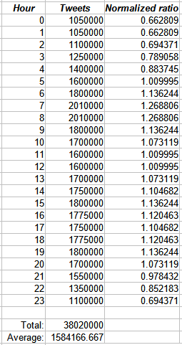
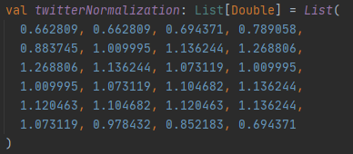
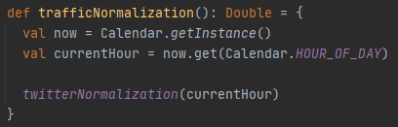
Sub-method: trafficNormalization
Twitter traffic varies by the time of day, so to account for that variation when we’re making our estimates we need to normalize the current count for the time of day.
This method:
Calls the current time
Gets the current hour from that time
Calls the normalization factor for that hour from the twitterNormalization List
Source: https://firstmonday.org/ojs/index.php/fm/article/view/4366/3654?utm_source=twitterfeed&utm_medium=twitter

Slide 21
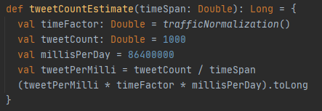
Method 5: tweetCountEstimate (Alternate)
Takes the given time span in millis
Gets the traffic normalization factor for the current time
Calculates the tweets per milli
Calculates the estimated number of daily tweets using the given formula.

Slide 22
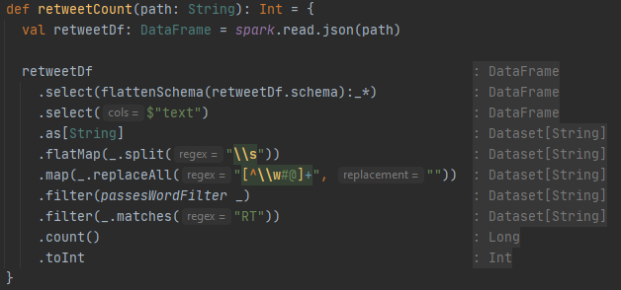
Method 6: retweetCount
Reads in the data
Splits the data into separate words
Removes all trivial characters
Filters for Strings longer than 0
Makes all words lowercase
Filters for non-trivial words
Matches for instances that contain “RT”
Counts the matches
Returns the count as an Int

Slide 23
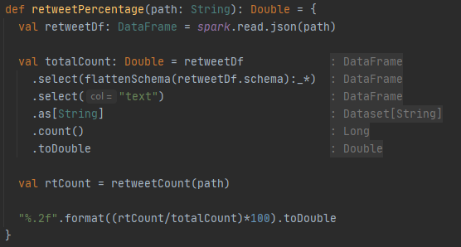
Method 7: retweetPercentage
Reads in the text data of each Tweet as a String
Counts up the number of Tweets by the number of Strings
Casts it to a Double
Calculates the number of Retweets by using the retweetCount method
Calculates a two-decimal-place formatted percentage by the given formula.

Slide 24
The Bot

Slide 25
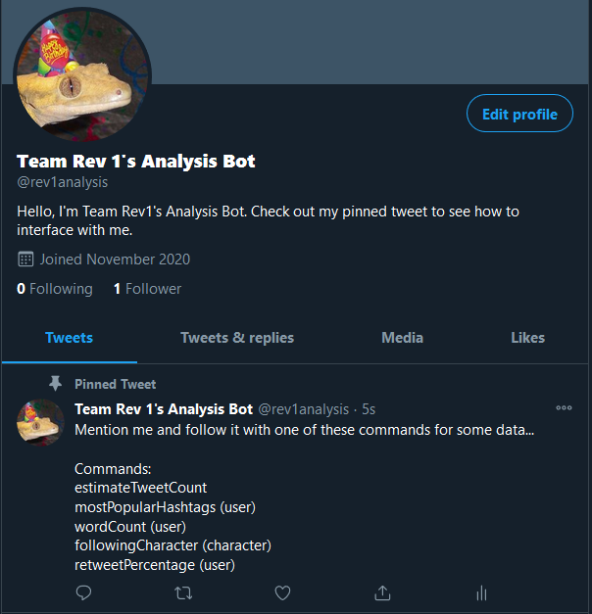
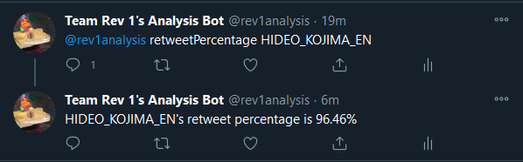
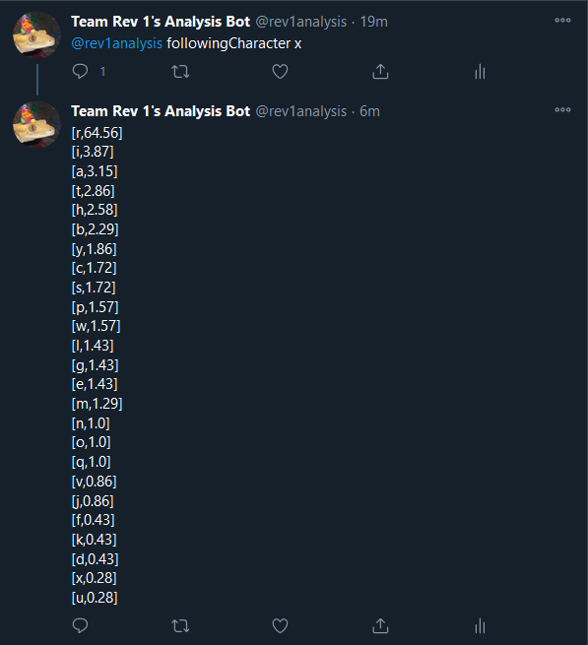

Slide 26
Basic Flow
Obtain new mentions of self from oldest to newest
For every mentions, use RegEx to validate queries and send them to their functions
Gather data via Twitter DAO and analyze it with AnalysisEngine
Tweet out reply to query
Wait five minutes before repeating the cycle

Slide 27
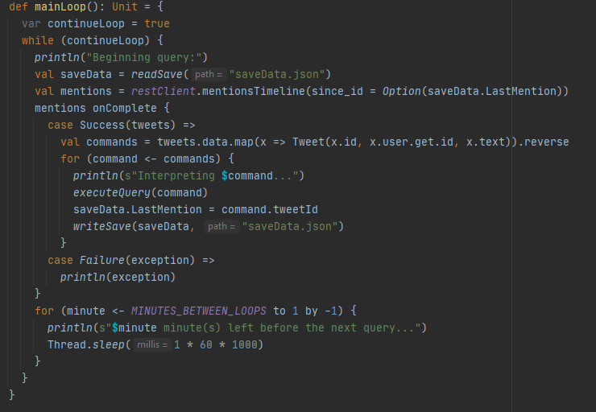
Main Method: mainLoop
Reads saved data from JSON
Retrieves all mentions from API, so long as they are newer than the last handled mention
Map mentions to Tweet objects and order from oldest to newest
Send mentions to be executed
Update save data to reflect that mention was handled
Wait five minutes before running loop again

Slide 28

Regex
Commands are interpreted by including a keyword and argument to the right of the mention
Arguments are often twitter usernames, but if a mention is used, the @ symbol is stripped from input

Slide 29
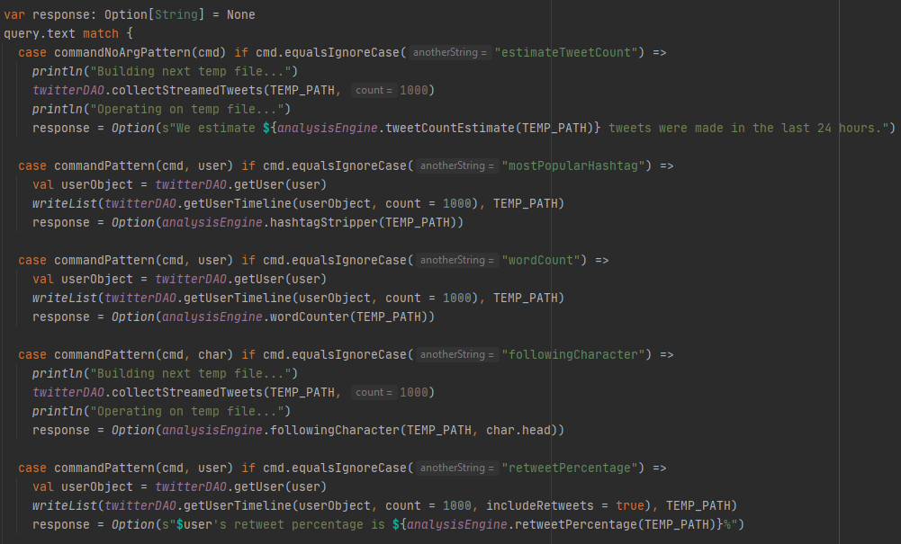
Subroutine: executeQuery
For general tweet queries, 1000 tweets are streamed and written to file
For queries involving a user’s timeline, up to 1000 tweets are pulled instead of streamed and written to file
Temp file is sent as an argument to the Analysis Engine’s corresponding function
The return of this function is packaged into a string and then tweeted back out to the prompting tweet

Slide 30
Questions?

Slide 31
GitHub Repository
https://github.com/TannerHall/revature-project2

Slide 32
Necessary Objects
TwitterUser:
userId: Long Unique ID given upon account creation
userName: String Unique string chosen by user
name: String Name chosen by user
createDate: DateTime Day and time user account was created
description: String Description set by user on profile
followers: Int Number of followers for user
following: Int Number of users following
Tweet:
tweetId: Long Unique ID given to tweet upon posting
authorId: Long Unique ID of user who posted the tweet (same as userId field of TwitterUser object)
text: String Text content of the tweet

